Slide 1
Hackathon 2025 Gen AI Orchestrator for Email and Document Triage Team : Cloud crowd
Visalakshi Mulukala
Meenakshi Telu
Deepika Palluri
Ashok Kumar Nakka

Slide 2
Email Classification and OCR App Using Hugging Face and Tesseract OCR
This application processes .eml files, classifies email content using Hugging Face's zero-shot classification model, and extracts text from image attachments using Tesseract OCR.
1. Prerequisites
Before running the code, make sure you have the following dependencies installed:
Python 3.6+: Ensure you're running a supported version of Python.
Required Libraries: Install the necessary Python libraries:
Tesseract OCR: You need to install Tesseract OCR. Follow these steps:
Download Tesseract OCR from official site.
Set the Tesseract executable path: Update the path in the code

Slide 3
Usage Flow
Directory Setup: Place your .eml email files in a directory.
Processing Emails: The script will iterate over all .eml files in the directory, parse the emails, classify their content, and extract text from image attachments if present.
Classification: The Hugging Face zero-shot classification model will classify the email into one of the predefined labels such as "Fee Payment" “AU Transfer“,”Closing Notice”.
OCR on Attachments: If the email has image attachments, Tesseract OCR will be used to extract text from those images.
Output: The results will be printed on the console.

Slide 4
5. Example Usage
Make sure the .eml files are stored in a directory (e.g., E:\Hackathon 2025\Sample Email Files). Then, call the process_multiple_emails(directory_path) function, passing the directory path to it.
Example:
directory_path = ‘E:/Hackathon 2025/Sample Email Files'
process_multiple_emails(directory_path)
This will:
Parse each .eml file in the specified directory.
Classify the email content into one of the predefined categories.
Extract text from any image attachments using Tesseract OCR (if applicable).

Slide 5
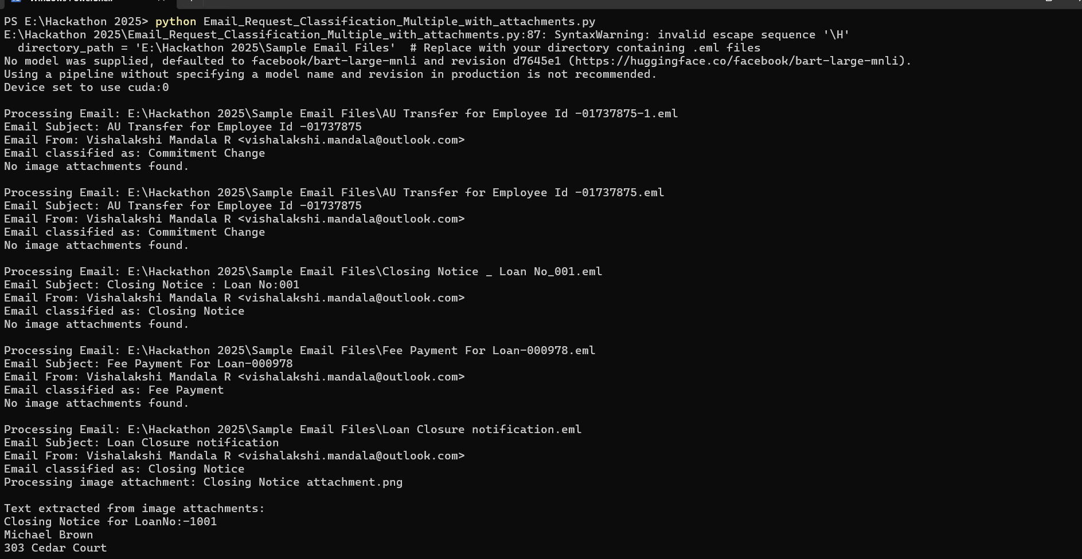
6. Sample Output
When you run the script with a directory containing .eml files, it will output something like this:
Run the below command:
Python Email_Request_Classification_Multiple_with_attachments.py

Slide 6
Email Classification and OCR App Using a Training Model with .csv Dataset and .eml Files for Classification
The above code can be modified to use training model with sample data set. We have tried to achieve the same .
Dependencies:
Hugging Face's transformers
pytesseract for OCR
PIL for image handling
torch and datasets for training the model

Slide 7
Steps Overview
Prepare the CSV Dataset: The dataset will have labeled email categories and associated text.
Train a Classification Model: Use a text classification model (like DistilBERT) from Hugging Face to classify the email content.
Parse the .eml Files: Extract email content from .eml files.
Classify the Emails: Classify the email text using the trained model.
OCR: Extract text from any image attachments in the emails.

Slide 8
Explanation of Key Steps:
CSV Dataset:
The CSV (emails.csv) contains labeled email data that is used to train the classification model.
The CSV should have at least two columns: email_subject, email_body, and label.
Model Training:
We load the CSV data and preprocess it by splitting it into training and validation sets.
We then tokenize the email body using Hugging Face's DistilBERT tokenizer.
The model is fine-tuned using Trainer from Hugging Face, which simplifies the training loop.
Email Parsing and OCR:
The .eml files are parsed to extract the subject, sender, and body.
The body is classified using the trained model.
If there are any image attachments in the .eml file, OCR is applied to extract text.
Multiple Emails:
The script can process all .eml files in a specified directory, classifying the emails and extracting text from any image attachments.

Slide 9
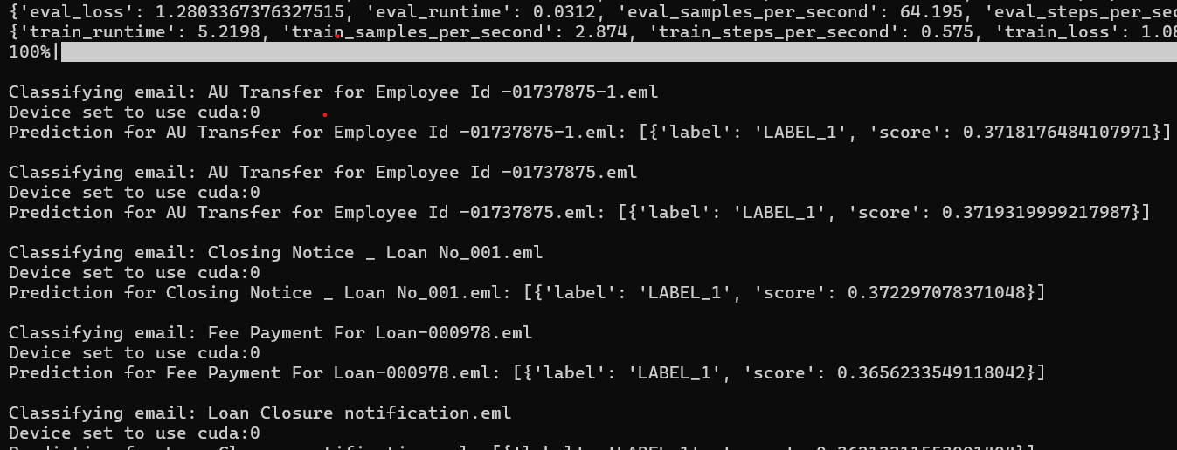
6. Sample Output
When you run the script with a directory containing .eml files and Provide .csv file for the training model, it will output something like this:
Run the below command:
Python Email_Request_Classification_Multiple_with_attachments_and_Training_Model.py

Slide 10
Conclusion
This script allows you to automate the classification of emails and extract useful data from image attachments using OCR. It integrates Hugging Face's classification models and Tesseract OCR for efficient and customizable email processing. It can be further enhanced by using advanced training model and we can train the model using Historical data set and achieve required email classification.

Slide 11
Thank You

